Slide 1
Event Handling

Slide 2



Text Fields and an Introduction to Event Handling with Nested Classes
GUIs are event-driven
  A user interaction creates an event
    Common events are clicking a button, typing in a text field, selecting an item from a menu, closing and window and moving the mouse
  The event causes a call to a method called an event handler

Slide 3

Text Fields and an Introduction to Event Handling with Nested Classes
Class JTextComponent
  Superclass of JTextField
    Superclass of JPasswordField
      Adds echo character to hide text input in component
  Allows user to enter text in the component when component has the application’s focus

Slide 4
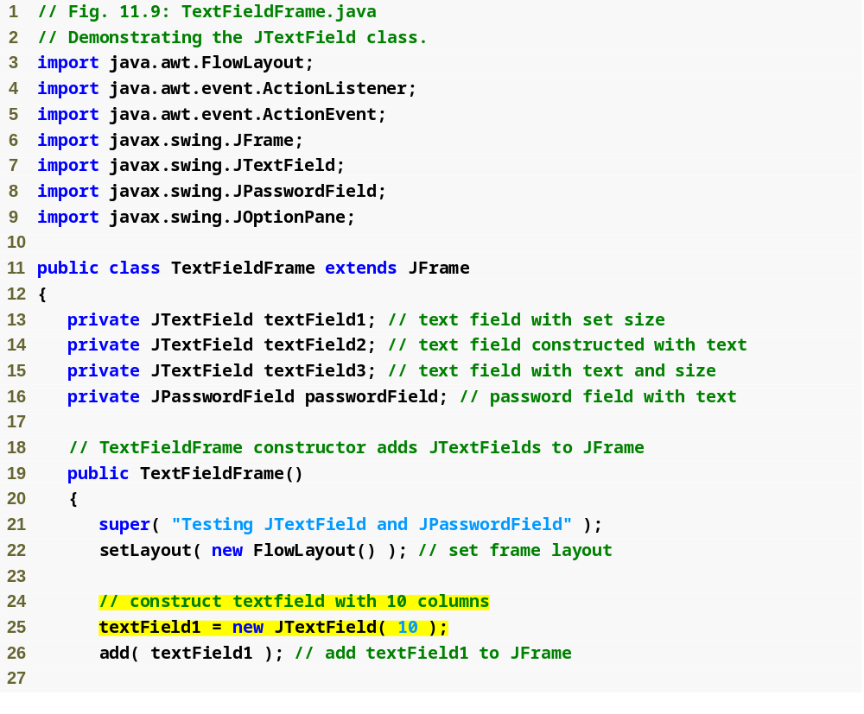
Outline
TextFieldFrame
.java
(1 of 3)
Create a new JTextField

Slide 5
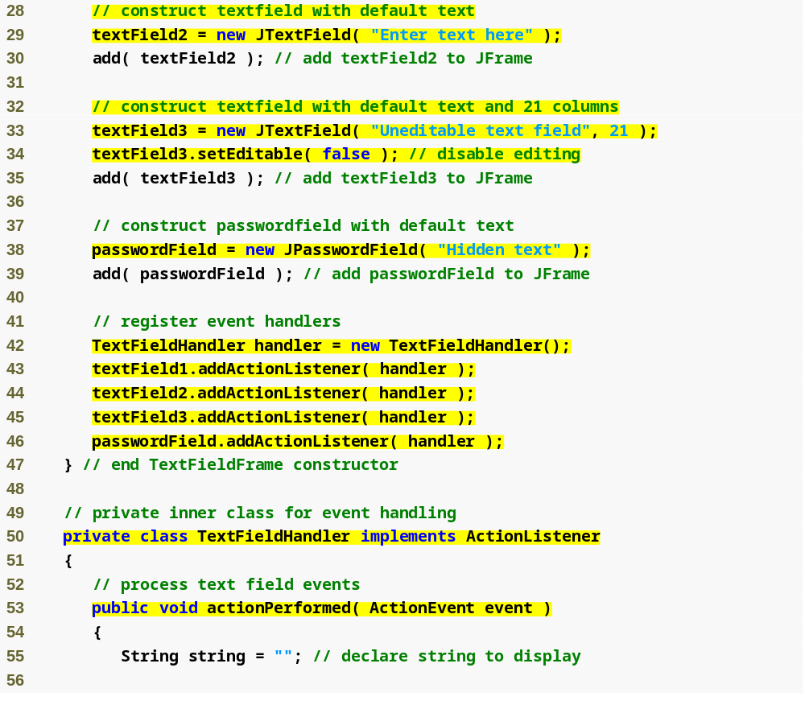
Outline
Create a new JTextField
TextFieldFrame.java (2 of 3)
Make this JTextField uneditable
Create a new JPasswordField
Create event handler
Register event handler
Create event handler class by implementing the ActionListener interface
Declare actionPerformed method

Slide 6
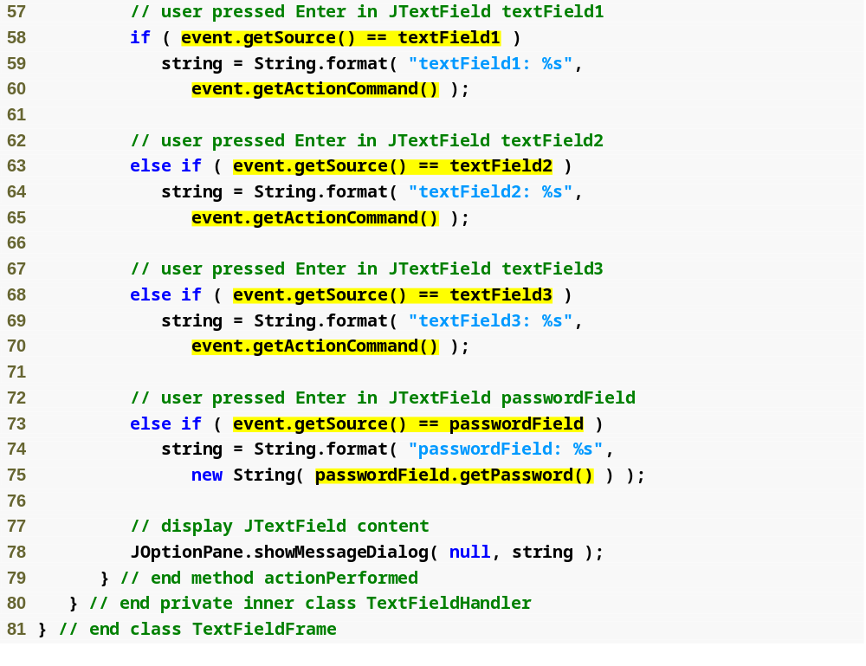
Outline
Test if the source of the event is the first text field
Get text from text field
TextFieldFrame
.java
(3 of 3)
Test if the source of the event is the second text field
Get text from text field
Test if the source of the event is the third text field
Get text from text field
Test if the source of the event is the password field
Get password from password field

Slide 7
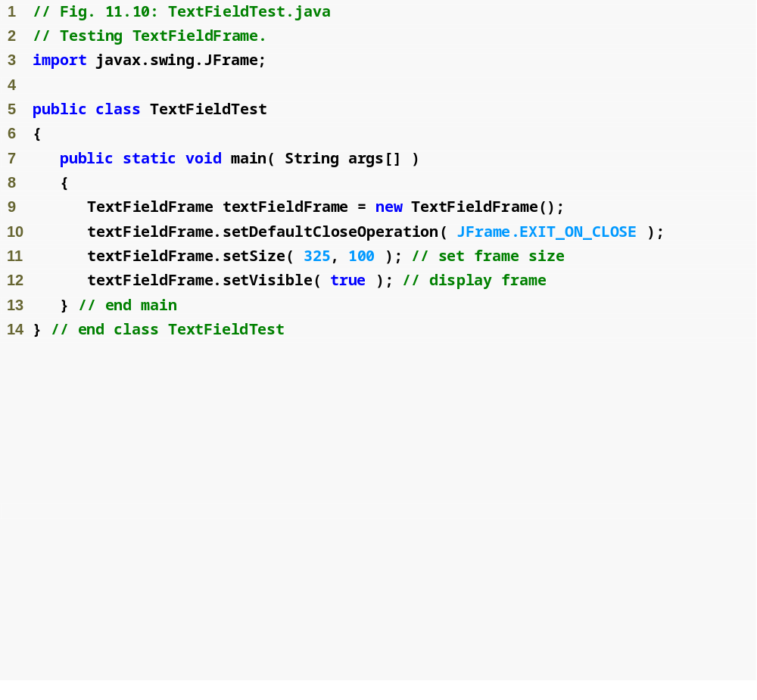
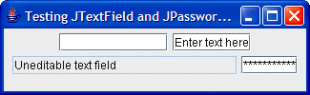
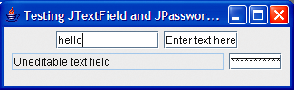
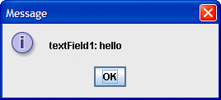
Outline
TextFieldTest
.java
(1 of 2)

Slide 8

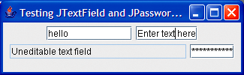
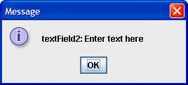
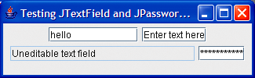
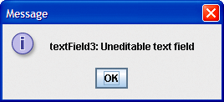
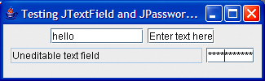
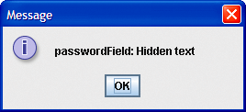
Outline
TextFieldTest
.java
(2 of 2)

Slide 9
Steps Required to Set Up Event Handling for a GUI Component
Several coding steps are required for an application to respond to events
  Create a class for the event handler
  Implement an appropriate event-listener interface
  Register the event handler

Slide 10
Using a Nested Class to Implement an Event Handler
Top-level classes
  Not declared within another class
Nested classes
  Declared within another class
  Non-static nested classes are called inner classes
    Frequently used for event handling

Slide 11
Using a Nested Class to Implement an Event Handler
JTextFields and JPasswordFields
  Pressing enter within either of these fields causes an ActionEvent
    Processed by objects that implement the ActionListener interface

Slide 12
Registering the Event Handler for Each Text Field
Registering an event handler
  Call method addActionListener to register an ActionListener object
  ActionListener listens for events on the object

Slide 13
Details of Class TextFieldHandler’s actionPerformed Method
Event source
  Component from which event originates
  Can be determined using method getSource
  Text from a JTextField can be acquired using getActionCommand
  Text from a JPasswordField can be acquired using getPassword

Slide 14
Common GUI Event Types and Listener Interfaces
Event types
  All are subclasses of AWTEvent
  Some declared in package java.awt.event
  Those specific to Swing components declared in javax.swing.event

Slide 15
Common GUI Event Types and Listener Interfaces
Delegation event model
  Event source is the component with which user interacts
  Event object is created and contains information about the event that happened
  Event listener is notified when an event happens

Slide 16
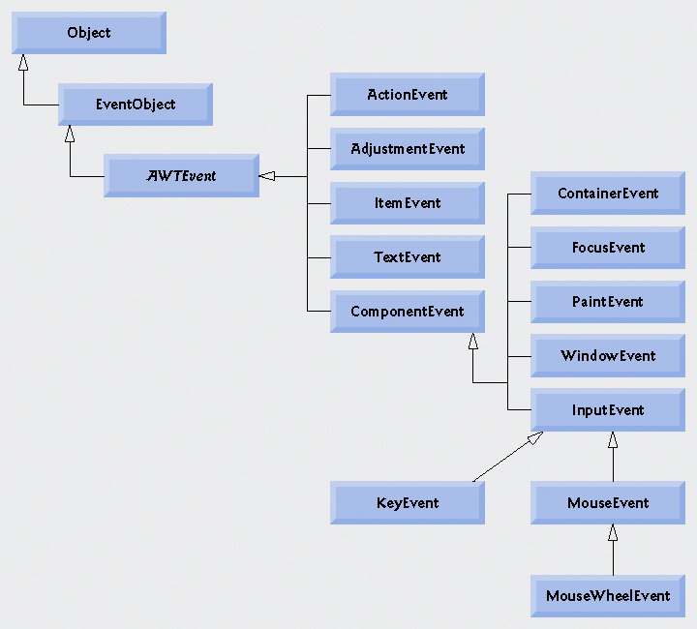
Fig. 11.11 | Some event classes of package java.awt.event.

Slide 17
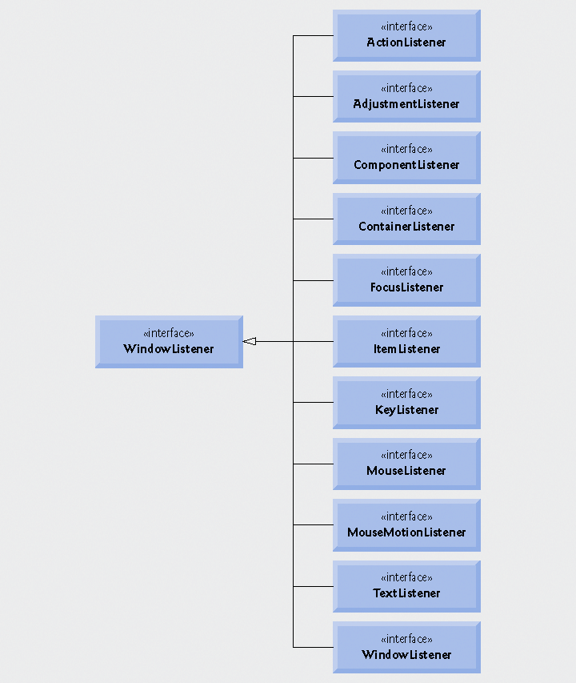
Fig. 11.12 | Some common event-listener interfaces of package java.awt.event.

Slide 18
How Event Handling Works
Remaining questions
  How did the event handler get registered?
  How does the GUI component know to call actionPerformed rather than some other event-handling method?

Slide 19
Registering Events
Every JComponent has instance variable listenerList
  Object of type EventListenerList
  Maintains references to all its registered listeners

Slide 20
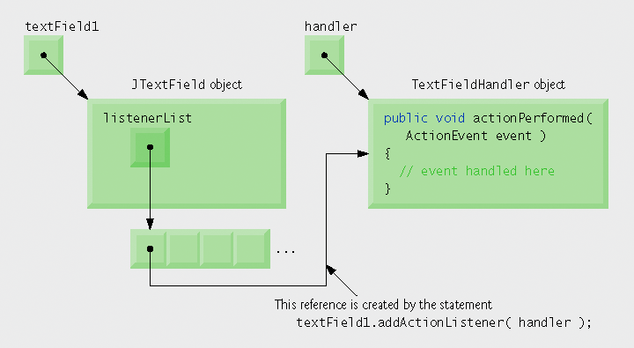
Fig. 11.13 | Event registration for JTextField textField1 .

Slide 21
Event-Handler Invocation
Events are dispatched to only the event listeners that match the event type
  Events have a unique event ID specifying the event type
MouseEvents are handled by MouseListeners and MouseMotionsListeners
KeyEvents are handled by KeyListeners

